Slide 1
PRINCIPAL’S REPORT

Slide 2
TOPICS
Winter MAP Data
Attendance Data
Mays Cluster Goals

Slide 3
WINTER MAP DATA

Slide 4
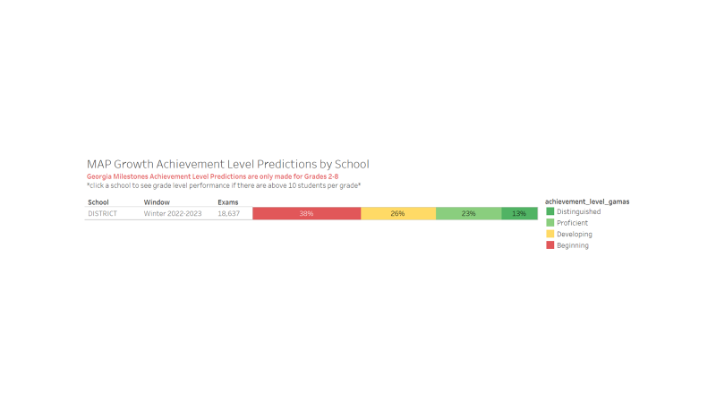
School-wide MAP Reading

Slide 5
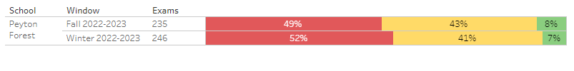
School-wide MAP Math

Slide 6
ATTENDANCE

Slide 7
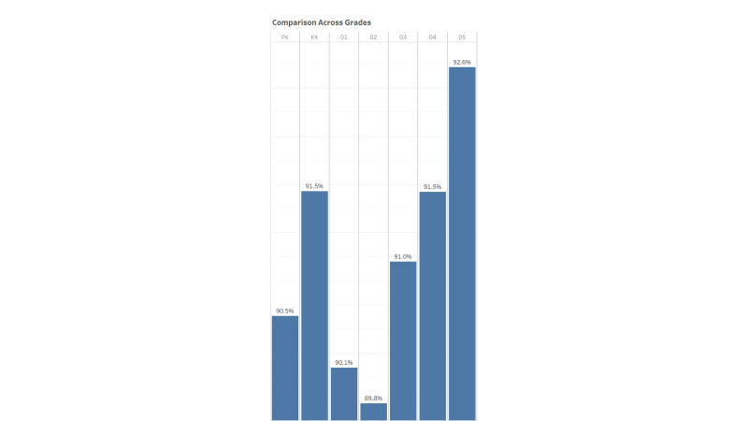
Attendance

Slide 8
MAYS CLUSTER GOALS

Slide 9
Priority 1 - Signature Programming
Priority 1 Notes:
Action Step: 75% of Mays Cluster Instructional Staff will participate in the IBO endorsed training by August 2023
  Success: 75% of the instructional will receive IBO endorsed certificates at the conclusion of the summer trainings
v Timeline: August 2023
Action Step: Professional Learning (Monthly)
  Success: Submission of Professional Learning Course Catalogues and staff sign in sheets to the building administrators using Kickup
v Timeline: May 2023
Action Step: Utilize the IB Walkthrough Form on Kickup
  Success: Kickup Reports
v Timeline: May 2023
Action Steps: Cluster IB Newsletters
Success: Quarterly submissions starting with the 3rd quarter and having the submissions posted on individual school websites
v Timeline: May 2023

Slide 10
Priority 2: Family Engagement
Priority Notes
Action Step: 1 instructional engagement event per quarter
  Success: Advertisements, Slideshows, Sign In Sheets, Agendas
v Timeline: May 2023
Action Step: All schools should have a functional CARE Team
  Success: Agendas, Meeting Trackers/Notes
v Timeline: May 2023

Slide 11
QUESTIONS?

Slide 12
Thank you

